Slide 1
LIBS 7014
Film Techniques

Slide 2
Film Form
“Filmmakers coordinate performance, composition, sound and editing to create meaning and tell a story” (Barsam&Monahan 32).
Mis-an-scène – lighting, setting, props, costumes and makeup
Sound – dialogue, music, ambience, sound effects
Narrative – development and resolution of character conflict

Slide 3
Editing
“Editing juxtaposes individual shots to create sequences (a series of shots unified by theme or purpose), arranges these sequences into scenes (complete units of plot action), and from these scenes builds a movie” (32).

Slide 4
Form and Content
“Content [is[ the subject of an artwork (what the work is about).
Form [is] the means by which that subject is expressed and experienced.
Form lets us see the content in a particular way. It enables the artist to shape our particular experience and interpretation of that content (32).

Slide 5
Film Form
“Form is cinematic language: the tools and techniques that filmmakers use to convey meaning and mood to the viewer, including
lighting, mis-an-scène, cinematography, performance, editing and sound” (32).

Slide 6
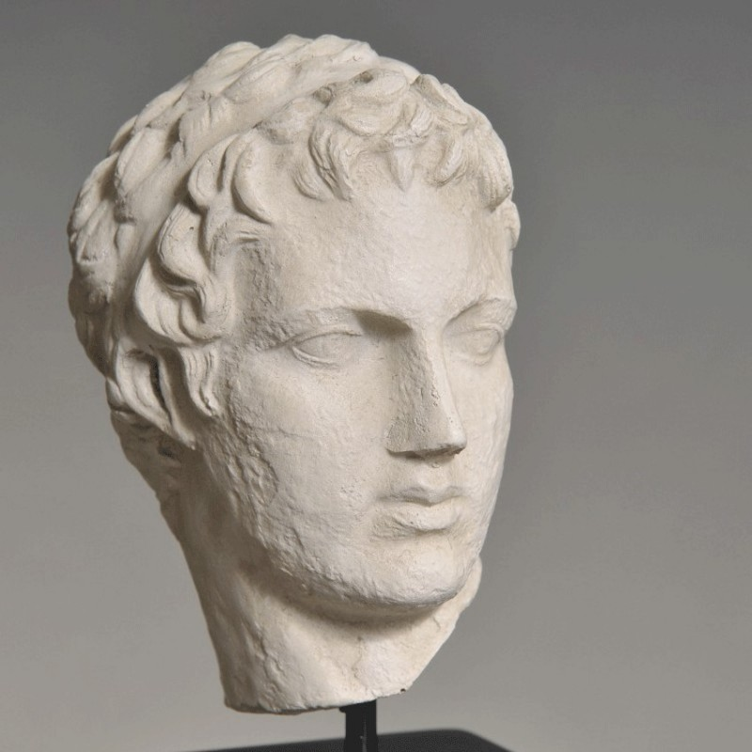
Greek Statue - Apollo

Slide 7
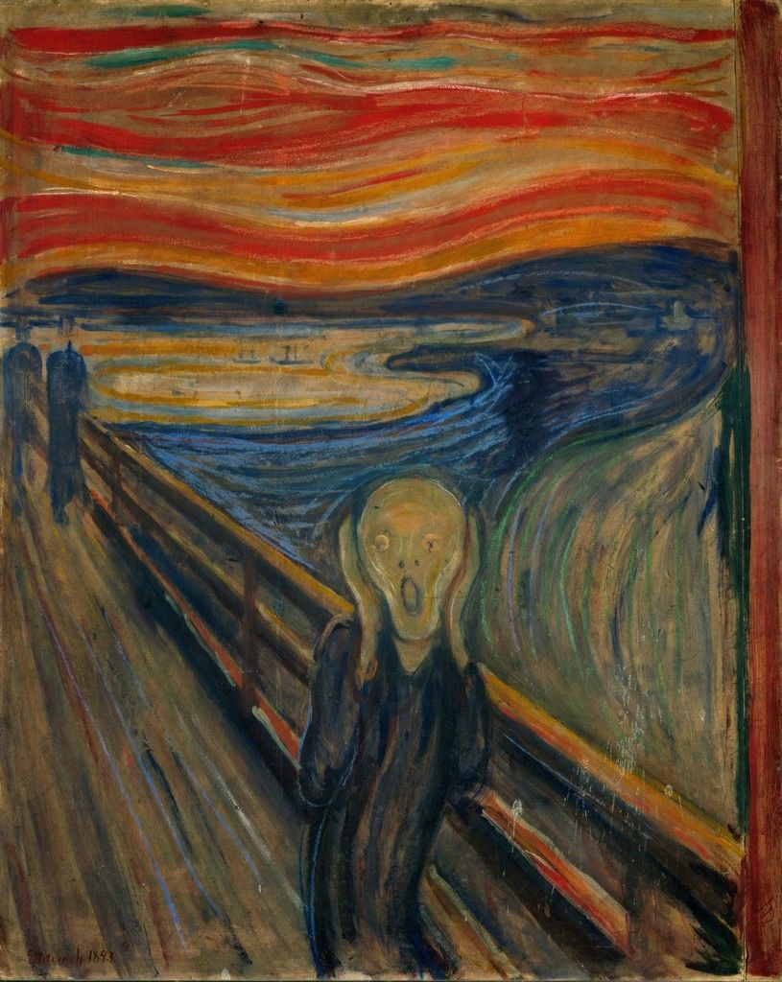
Edvard Munch The Scream 1893

Slide 8
Portrait History
http://www.family-portrait.net/portraithistory.php

Slide 9
Form and Expectation
The audience asks questions about the story’s outcome: Will Frodo destroy the ring?
Revising expectations
Hitchcock’s MacGuffin – “an object …. important to the characters and motivates their actions but that turns out to be less important to the overall narrative” (Barsam&Monahan 36).

Slide 10
Identification
Bela Balazs Theory of the Film. Growth of a New Art
“In the cinema the camera carries the spectator into the film picture itself. We are seeing everything from the inside as it were and are surrounded by the characters of the film. They need not tell us what they feel, for we see what they see and see it as they see it. Although we sit in our seats for which we have paid, we do not see Romeo and Juliet from there. We look up to Juliet's balcony with Romeo's eyes and look down on Romeo with Juliet’s. Our eye and with it our consciousness is identified with the characters in the film, we look at the world out of their eyes and have no angle of vision of our own.”

Slide 11
Identification
“We walk amid crowds, ride, fly or fall with the hero and if one character looks into the other's eyes, he looks into our eyes from the screen, for, our eyes are in the camera and become identical with the gaze of the characters. They see with our eyes. Herein lies the psychological act of 'identification'.”

Slide 12
Visual Culture
“The gestures of visual man are not intended to convey concepts which can be expressed in words, but such inner experiences, such non-rational emotions which would still remain un­expressed when everything that can be told has been told.”

Slide 13
Charlie Chaplin VS a Revolving Door
https://www.youtube.com/watch?v=vWIopUcHBOg

Slide 14
Elements of Film Language
“What is it that the film does not reproduce but produce, and through which it becomes an independent, basically new art after all?
the changing distance, the detail taken out of the whole, the close-up, the changing angle, the cutting, and what is the most important : a new psychological effect achieved by the film through the devices just mentioned. This new psychological effect is identification.”

Slide 15
Camera Angle
“The angle is what gives all things their shape and the same thing taken from different angles often gives a completely dissimilar picture. This is the strongest means of characterization the film possesses; and it is not reproduction but genuine production.”
Vertigo
https://www.youtube.com/watch?v=GnpZN2HQ3OQ

Slide 16
Alfred Hitchcock Frame By Frame
https://www.youtube.com/watch?v=s3p_zsv7K4g
Hitchcock Techniques (2004) Part 3/2
https://www.youtube.com/watch?v=0xuy0-yGyrE
https://www.youtube.com/watch?v=Eg6velhQxGs

Slide 17
What is film montage?
Bela Balazs Theory of the Film. Growth of a New Art
“Montage, that is the assembly of 'shots' in a certain order in which not only whole scene follows whole scene (however short) but pictures of smallest details are given, so that the whole scene is composed of a mosaic of frames aligned as it were in chronological sequence.”

Slide 18
Montage
“This revolutionary innovation in visual artistic expression came about in the United States of America, in Hollywood, during the First World War. David Griffith was the name of the genius to whom we owe it. He not only created masterpieces of art, but an art that was totally new.”

Slide 19
Montage
“A good film director does not permit the spectator to look at a scene at random. He leads our eye inexorably from detail to detail along the line of his montage. By means of such a sequence the director is enabled to place emphasis where he sees fit, and thus not only show but at the same time interpret the picture.”

Slide 20
Montage
“What we have learnt is to integrate single disjointed pictures into a coherent scene, without even becoming conscious of the complicated psychological process involved.”

Slide 21
Montage
“Cutting is the ultimate integrating work on the film, which is quite apart from the shooting of the pic­ture and which creates the rhythm and that process of associa­tion of ideas which again cannot be reproduction, if for no other reason , because there is no original to reproduce in this phase of film creation, not even as much as the painter has in his model. Montage, the mobile architecture of the film‘s picture -material, is a specific, new creative art” (Balazs).

Slide 22
Functions of Editing
Organize fragmented action and events.
Create meaning through juxtaposition.
Create special relationships between shots.
Create temporal relationships between shots.
Establish and control shot duration, pace and rhythm.
(Barsam&Monaham 285)

Slide 23
Parallel Editing - crosscutting
Parallel editing is “a technique that makes different lines of action appear to be occurring simultaneously” or “… cuts back and forth between two or more actions happening simultaneously in separate locations” (Barsam&Monahan 37; 287)
Raising Arizona (Joel and Ethan Coen 1987) - the chase scene
https://www.youtube.com/watch?v=1OUoJGdLfis

Slide 24
Juxtaposition
Juxtaposition is placing two shots together in a sequence.
“The creation and communication of meaning through juxtaposition is montage editing.”

Slide 25
Lev Kuleshov Effect
https://www.youtube.com/watch?v=_gGl3LJ7vHc
“Kuleshov demonstrated a creative capacity of film editing: the juxtaposition of images to create new meaning not present in any single shot by itself” (289).

Slide 26
Vsevolod Pudovkin
He demonstrated that shot order can influence meaning.
Three close-up shots
A a pointed pistol
B a man looking frightened
C the same man smiling
BAC
BA the man is frightened by the gun + C the man overcomes his fear
CAB – the mean reacts with cowardice
This proves the flexibility of the viewer's psychology.

Slide 27
Associative Editing
Associative editing, also known as intellectual editing, uses juxtaposition to impart meaning in a more direct way than montage editing, which is intuitive.
“Associative editing pairs contrasting or incongruent images in a manner that implies a thematic relationship” (291).

Slide 28
Apocalypse Now (Coppola, 1979)
Parallel montage
https://www.youtube.com/watch?v=6TZnlmwwo2I

Slide 29
Continuity Editing
“Continuity Editing seeks to keep viewers oriented in space and time to ensure a smooth and subtle (preferably invisible) flow between shots and to maintain a logical connection between adjacent shots and scenes” (300)

Slide 30
Discontinuity Editing
“Discontinuity Editing […] emphasizes dynamic, often discontinuous relationships between shots, including contrasts in movement, camera angle and shot type. This approach deliberately incorporates abrupt spatial and temporal shifts between shots….”

Slide 31
Jump Cut
“A jump cut is created when two shots of the same subject taken from the same camera position are edited together so that the action on-screen seems to jump forward in time.”
Royal Tenenbaums (Wes Anderson 2001)
https://www.youtube.com/watch?v=K2GPBBxFpEw

Slide 32
Great Editing
Top 10 Most Effective Editing Moments of All Time
https://www.youtube.com/watch?v=bQtkbQkURCI

Slide 33
Types of Shots
POV Shot
A shot that depicts the point of view of a character so that we see exactly what they see. It is often used in Horror cinema to see the world through a killer's eyes. (http://www.empireonline.com/movies/features/film-studies-101-camera-shots-styles/)

Slide 34
The Dutch angle
The Dutch angle, also known as Dutch tilt, canted angle, oblique angle or German angle, is a type of camera shot where the camera is set at an angle on its roll axis so that the shot is composed with vertical lines at an angle to the side of the frame, or so that the horizon line of the shot is not parallel with the bottom of the camera frame. This produces a viewpoint akin to tilting one's head to the side (Wikipedia).

Slide 35
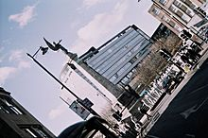
The Dutch angle

Slide 36
The Dolly shot
The dolly shot is named for the device that creates it, the camera dolly--a wheeled camera support that can be rolled left and right or forward and backward in a behind-the-scenes.
A tracking shot is when a camera follows a person or an object physically moving with the subject- This can be done using tracks, handheld, ropes, Steady-cam etc.
http://www.criticalcommons.org/Members/jbutler/clips/greysanatomy20061005qq31_33qqdollyshot.mp4

Slide 37
The Pan shot
In cinematography, panning refers to rotating or pivoting a motion picture or video camera horizontally from a fixed position. This motion is similar to the motion a person makes when they turns their head on their neck from left to right. In the resulting image, the view seems to "pass by" the spectator as new material appears on one side of the screen and exits from the other, although perspective lines reveal that the entire image is seen from a fixed point of view.
The term panning is short for panorama suggesting an expansive view that exceeds the gaze, forcing the viewer to turning her head to take everything in. Panning, in other words, is a device for gradually revealing and incorporating off-screen space into the image (Wikipedia).

Slide 38
Examples
Top 20 Amazing Cinematic Techniques Part 1
https://www.youtube.com/watch?v=O3EnnBDgMww

Slide 39
Camera Shots
Film Studies 101: The 30 Camera Shots Every Film Fan Needs To Know
http://www.empireonline.com/movies/features/film-studies-101-camera-shots-styles/

Slide 40
Eisenstein's “Montage of Attractions“ by Dan Shaw
February 2004, Senses of Cinema, Issue 30
http://sensesofcinema.com/2004/great-directors/eisenstein/

Slide 41
Discussion Questions
“Sergei Eisenstein” Dan Shaw
February 2004, Senses of Cinema. Issue 30
http://sensesofcinema.com/2004/cteq/eisenstein/"http://sensesofcinema.com/2004/cteq/eisenstein/
What is intellectual montage?
Define the editing techniques of metric, rhythmic, tonal and overtonal montage.
What is the purpose of art, according to Eisenstein, Marx, Brecht, and Godard?
How are Eisenstein’s experiments in montage related to biomechanics?
What is, according to some critics, problematic about Eisenstein’s avoidance of the cult of the individual?
How did Eisenstein influence later film directors? Give some examples.
What is the difference between Eisenstein’s approach to cinema defined as “Kino-fist”and the “Kino-Eye” group?
What are the weaknesses of Eisenstein’s approach to art?

Slide 42
Sergei Eisenstein
Ideas about Art
For Eisenstein (as for Marx, and Brecht, and Godard), art should raise class-consciousness and transform the viewer, ideally causing the audience to take up arms against their sea of troubles as soon as they leave the theatre.
He expressed his ideas about art in his seminal 1931 essay “A Dialectic Approach to Film Form”.

Slide 43
“Eisenstein's Montage of Attractions"
Eisenstein's first film, the revolutionary "Strike," was produced in 1924, following the publishing of his first article on theories of editing in the review Lef, edited by the great poet, Mayakovsky. He proposed a new editing form, the "montage of attractions" -- in which arbitrarily chosen images, independent from the action, would be presented not in chronological sequence but in whatever way would create the maximum psychological impact.

Slide 44
Intellectual Montage
Just as the conflict of classes drove history – with the bourgeoisie as thesis clashing with the proletariat as antithesis to yield the triumphant progressive synthesis of the classless society – so too (famously, in Strike!) shot A of the workers’ rebellion being put down is juxtaposed with shot B of cattle being slaughtered and the synthesis yields the symbolic meaning C, that the workers are cattle. This technical innovation is what Eisenstein dubbed “intellectual montage.”

Slide 45
Eisenstein
While Eisenstein was proudest of his “invention” of intellectual montage in the parallel bloodbaths in Strike! (1924), what most endures about his work is his mastery of the editing techniques he identified as metric, rhythmic, tonal and overtonal in “Methods of Montage”. In his view, editing involved the audience more than the passive reception of information from static and lengthy shots; that as viewers we actively come to the symbolic realisations of intellectual montage, and are driven into a Pavlovian frenzy by the dynamism of the rhythms of the Odessa Steps, or the rat-a-tat of the machine gun in October (1927) (Dan Shaw).

Slide 46
Intellectual Montage: Slaughter Scene from Strike (1924)
http://www.youtube.com/watch?v=jWiDciPuSW4
Intellectual montage resulted from his studies of Kuleshov’s famous experiments (which demonstrated that the meaning of any shot is contextual) and of Japanese ideograms (where two separate symbols can be juxtaposed to create a third meaning, e.g. child + mouth = scream, white bird + mouth = sing)

Slide 47
Odessa Steps: Battleship Potemkin (1925)
https://www.youtube.com/watch?v=1sEPFd-1Dm8&spfreload=10

Slide 48
Rhythmic Montage
Eisenstein discovering that film cut metrically to the beat of a typical heart has a profound impact on us precisely because it mirrors our biorhythms. He learned how to whip his viewers into a frenzy (much easier than now) by using such simple tricks as making the shots shorter and shorter to build to a climax (see the end of the crop duster sequence in North by Northwest for a definitive use of accelerated montage). His films were composed of an astronomical number of shots, a necessity when, say, you are trying to capture the power of a machine gun by cutting as rapidly as it fires bullets. But the shower scene from Psycho would not exist were it not for Eisenstein’s inspired lead in.

Slide 49
Examples
North by Northwest(1959) the crop duster sequence
http://www.youtube.com/watch?v=943mBjmDZ4Q&NR=1&feature=endscreen
Psycho (1960) - shower scene
http://www.youtube.com/watch?v=0WtDmbr9xyY&feature=fvsr

Slide 50
Overtonal Montage
October
He was one of the first directors to cut a film to the rhythm of pre-existent music, and not just have the music played or composed to match the film.
http://www.youtube.com/watch?v=XwN5ndR65QM

Slide 51
Influence
Many of the most memorable sequences in film history (e.g., the final climax of The Godfather, with Al Pacino renouncing Satan at his son’s baptism as his henchmen simultaneously enact multiple murders at his behest) would never have been shot had the Easy Riders and Raging Bulls of the 1970s not studied Eisenstein at length in the film schools of the 1960s.

Slide 52
Influence
Shooting events from multiple perspectives has been incorporated in many films since (e.g. when Jeanne Moreau jumps into the Seine in Truffaut’s Jules and Jim), echoing the sequences in Potemkin where the sailor breaks the dish and in October where the dead white horse falls off the drawbridge.

Slide 53
Influence
Intellectual Montage
It can be put to elegant, complex and thought-provoking use such as the match cut from the thigh bone rising to the space ship in free fall in 2001: A Space Odyssey
http://www.youtube.com/watch?v=mI3s5fA7Zhk&feature=related

Slide 54
Influence
Steps sequence has often been imitated (e.g. in De Palma’s version of The Untouchables [1987]) but never duplicated.
http://www.youtube.com/watch?v=O-3DKkIv9S8

Slide 55
Influence
As a propagandist, none of Eisenstein’s efforts are as viscerally effective as Triumph of the Will, where Leni Riefenstahl demonstrated that many of his cinematic innovations could be put just as easily in service to fascism as to Communist liberation.

Slide 56
Nazi Propaganda
Adolf Hitler in his book Mein Kampf (1926) first advocated the use of propaganda to spread the ideals of National Socialism -- among them racism, antisemitism, and anti-Bolshevism.

Slide 57
Nazi Propaganda
In 1933, Hitler established a Reich Ministry of Public Enlightenment and Propaganda headed by Joseph Goebbels. The Ministry's aim was to ensure that the Nazi message was successfully communicated through art, music, theater, films, books, radio, educational materials, and the press.

Slide 58
Cont.
During periods preceding legislation or executive measures against Jews, propaganda campaigns created an atmosphere tolerant of violence against Jews, particularly in 1935 (before the Nuremberg Race Laws of September) and in 1938 (prior to the barrage of antisemitic economic legislation following Kristallnacht.

Slide 59
Films and Nazi Propaganda
Films in particular played an important role in disseminating racial antisemitism, the superiority of German military power, and the intrinsic evil of the enemies as defined by Nazi ideology. Nazi films portrayed Jews as "subhuman" creatures infiltrating Aryan society. For example, The Eternal Jew (1940), directed by Fritz Hippler, portrayed Jews as wandering cultural parasites, consumed by sex and money. Some films, such as The Triumph of the Will (1935) by Leni Riefenstahl glorified Hitler and the National Socialist movement.
From Holocaust Encyclopedia:
http://www.ushmm.org/wlc/en/article.php?ModuleId=10005202

Slide 60
Triumph of the Will by Leni Riefenstahl
http://www.youtube.com/watch?v=GHs2coAzLJ8

Slide 61
Jew Süss and the Eternal Jew
Jew Süss (1940) directed by Veit Harlan, made at the request of Joseph Goebbels
http://www.youtube.com/watch?v=ZIvaBOxHDj0
The Eternal Jew (1940) an antisemitic Nazi propaganda film directed by Fritz Hippler
https://www.youtube.com/watch?v=dnX4Y-GAWPo

Slide 62
Stalin Propaganda Films
http://www.youtube.com/watch?v=wlvYGqi3Dbc

Slide 63
Burnt by the Sun Nikita Mihalkov
http://www.youtube.com/watch?v=Ah6ascEyRKo
Sergei vs Dimitri. The movie is set in 1936, Russia, after the Bolshevik Revolution. Colonel Sergei Kotov is one of the revolutionary heroes. Dimitri (Hans) is an officer in Stalin's secret police.

